Slide 1
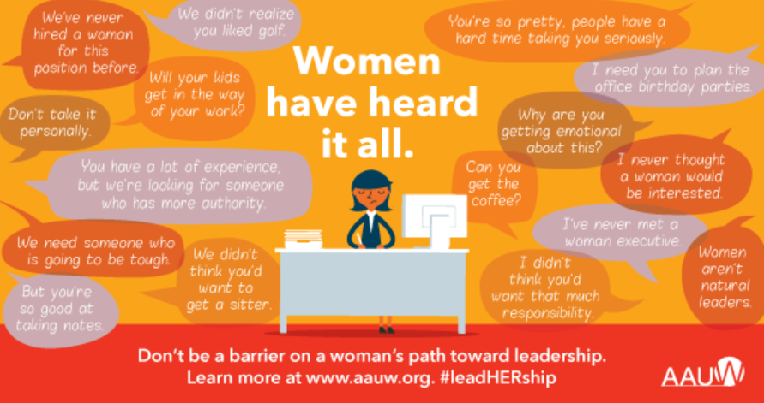
CEOs in Corporate America
Deniesha, Jada, Lydmarie, Saribel

Slide 2
Why this topic?
-Women began to really make an entrance into workplaces and embracing the idea of “independent female workers”, in the 1830s-1980s.
-It serves the purpose of emphasizing the importance of consciousness that community represents unity and equality for everyone in it.
-Its also serves as a foundation of support for the claim that women have been underrepresented in most labor fields, and it shows the improvement throughout the years.
Notes:
-way later than men

Slide 3

Methodology
layout = go.Layout(
#Title of the Graph
title = 'Share of CEOs',
#Name of the X-axis
xaxis=go.layout.XAxis(
title=go.layout.xaxis.Title(
text='Year'
#Name of Y-axis
yaxis=go.layout.YAxis(
title=go.layout.yaxis.Title(
text='Percentages'
fig = go.Figure(data=[wcdfbar], layout=layout)
plot(fig)
Import pandas
dir(pandas)
import plotly
dir(plotly)
from plotly.offline import plot
import plotly.graph_objs as go
wcdf = pandas.read_excel("GISdata.xlsx",sheet_name = "womenCEOs")
wcdf
wcdfbar = go.Bar(x=wcdf["Year"], y = wcdf["CEOs"],
marker = {"color": wcdf["CEOs"],
"colorscale" : "Jet"})

Slide 4
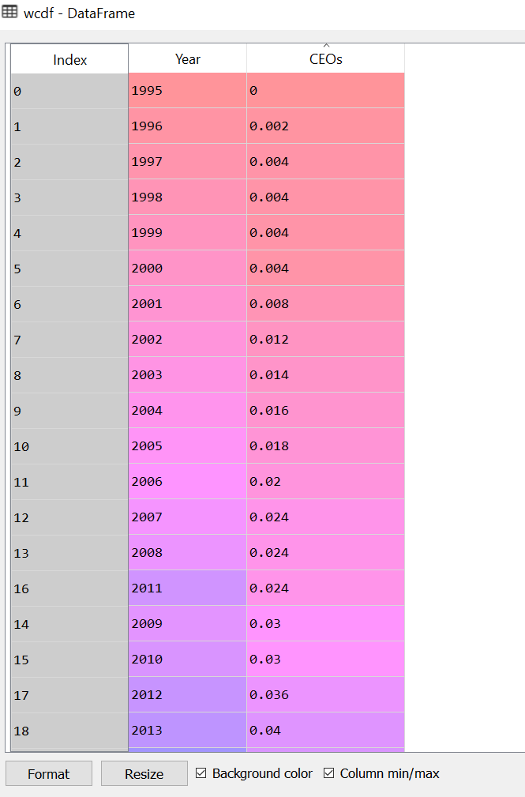
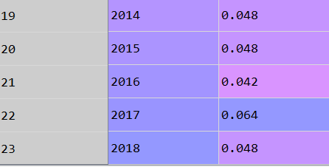
The Data Frame Results

Slide 5
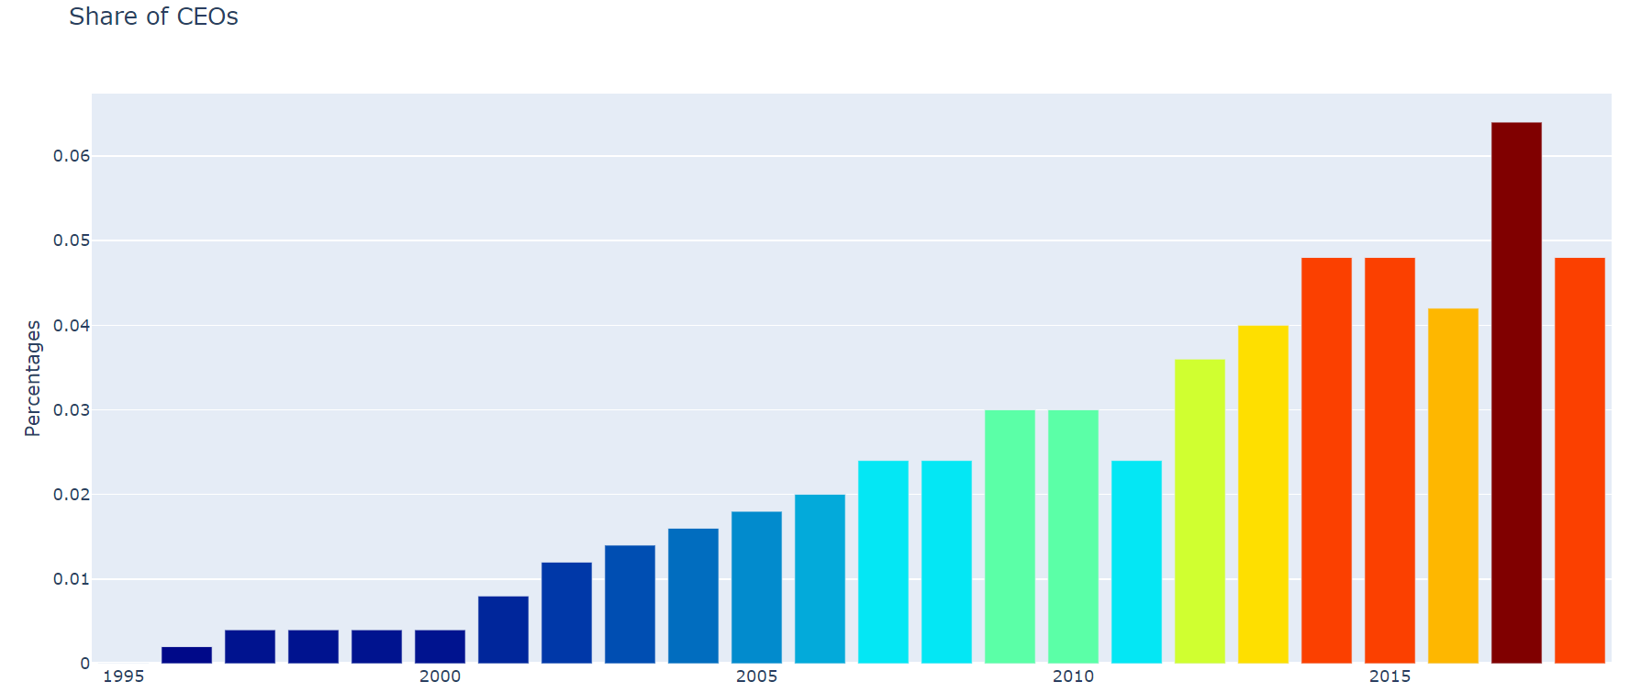
Data Graph

Slide 6
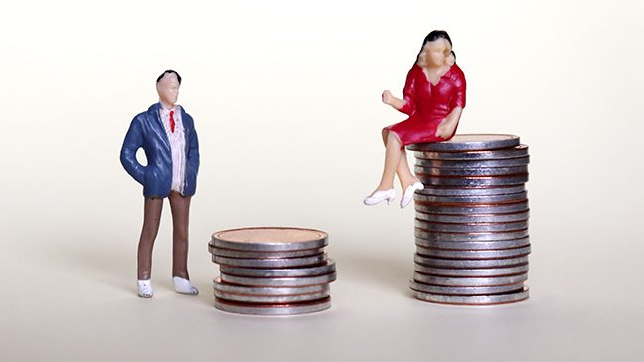
WOMEN VS MEN
WOMEN PAID MORE THAN MEN!!
Handful of elite women
$22.7mil > $14.9mil***
Demanding better or equal pay
Gender gap DOES exist!!
*** Huffington Post
https://tinyurl.com/y5wv9ujr

Slide 7
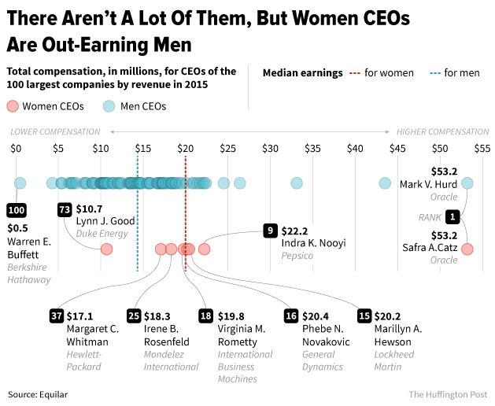

Slide 8
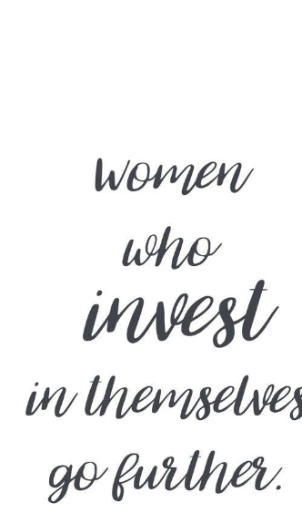
Concluding Points
-We can see in the data graph how the growth of participation in regards to female employees in workplaces has been great, and we need to acknowledge that without teamwork, none of this would've been possible.
- Women have worked for many years, and we have gotten the results we were hoping for but we do need to stay mindful that not every work corporation have these high percentages and female involvement. Therefore, we need to continue to grow on a larger scale.
- In other words OUR WORK ISN'T DONE!!

Slide 9

Thank you. Questions?

